Slide 1
Customer Churn Analysis of VoIP Provider
Lilik Pratama
lppratama12@gmail.com

Slide 2
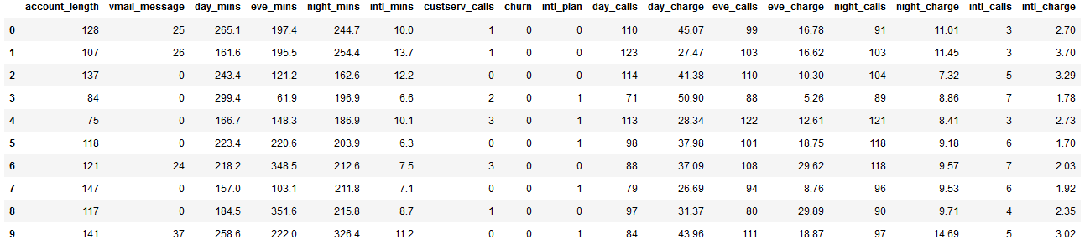
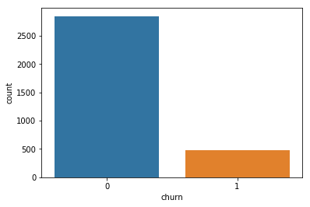
Data
Source: http://bitly.com/churn-data-dqlab
Data size: 3333 rows x 18 columns
Targeted column: ‘churn’
All columns data type is numerical
No missing value
Staying Cutomer: 2850
Leaving Customer: 483

Slide 3
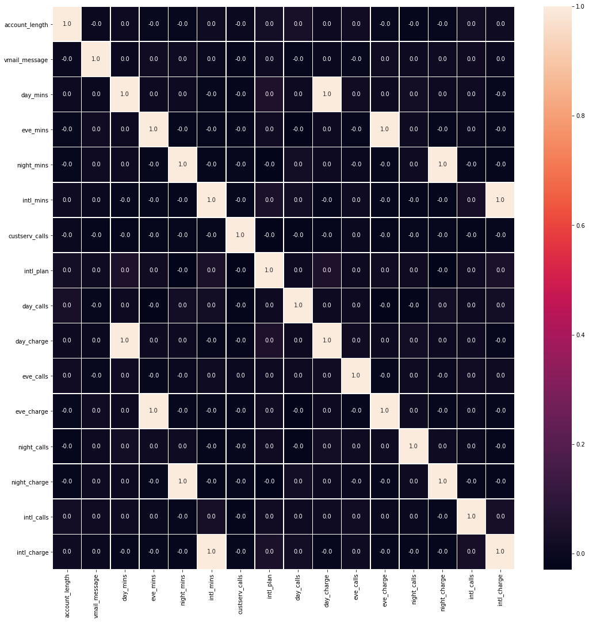
Correlation Map
Features correlated each other:
day_mins with day_charge
eve_mins with eve_charge
night_mins with night_charge
intl_mins with intl_charge
Dropped features:
day_mins
eve_mins
night_mins
intl_mins
Used features:
account_length, vmail_message, custserv_calls, intl_plan, day_calls, day_charge, eve_calls, eve_charge, night_calls, night_charge, intl_calls, intl_charge

Slide 4
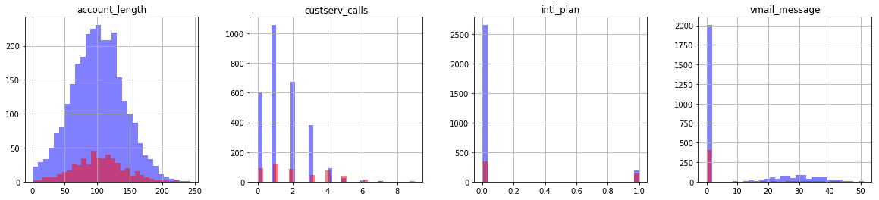
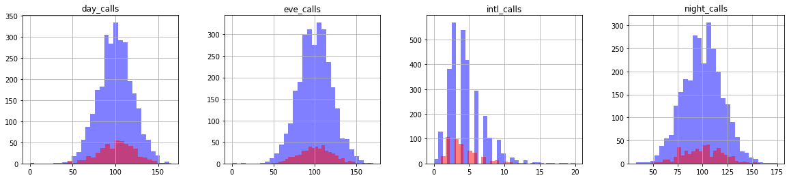
Subplot
Customers who have international plan tends to churn. Customers who called CS 4 times or more, tends to churn.
Customer churn behavior quite hard to predict based on call numbers. Need more insight.

Slide 5
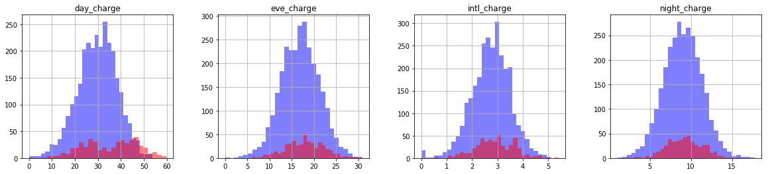
Subplot (cont.)
From the day_charge subplot, customers tend to churn when the charge of day calls around 50 or more.
Therefore there are three features that make customers churn: day_charge, custserv_calls, intl_plan.
Insight on more features, will be obtained from data modeling.

Slide 6
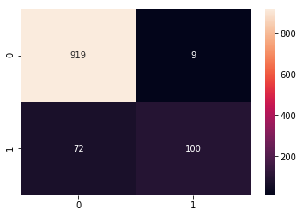
Data Modeling
Since Random Forest accuracy is highest, it’ll be used for our data modeling.
The confusion matrix for the test data set as below.
Using Python and comparing every Classification algorithms accuracy, we get:
Logistic Regression: 0.863861
Linear Discriminant Analysis: 0.859833
K-Nearest Neighbor: 0.862954
Decision Tree: 0.914027
Gaussian NB: 0.845504
Support Vector Machine: 0.860718
Random Forest: 0.931036

Slide 7
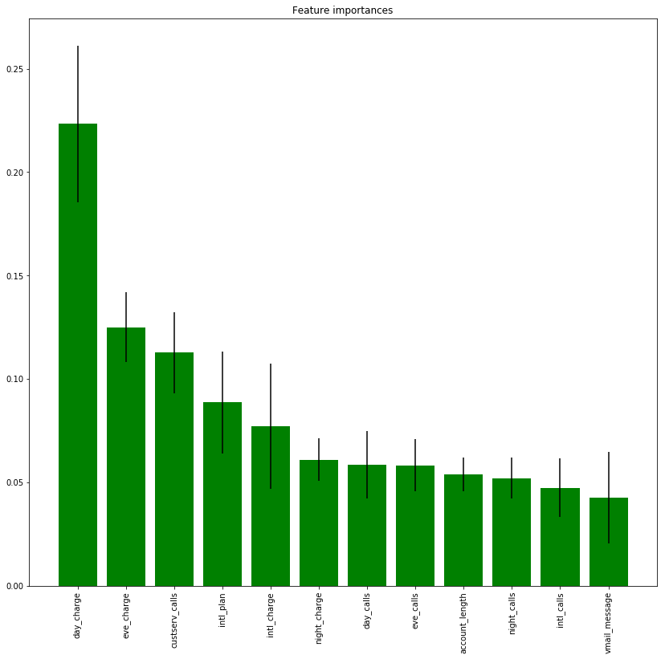
Important Features
Based on Random Forest model that have been built, we get important features as below.
The top 6 features are:
day_charge
eve_charge
custserv_calls
int_plan
intl_charge
night_charge
In order to lower the customers churn therefore it’s recommended to:
Lower the charge for the calls
Reconsider the international planning
Increase the quality of our Customer Service

